Slide 1
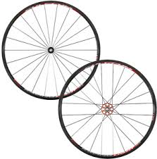
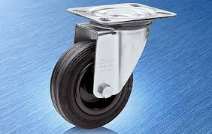

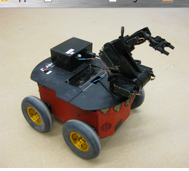
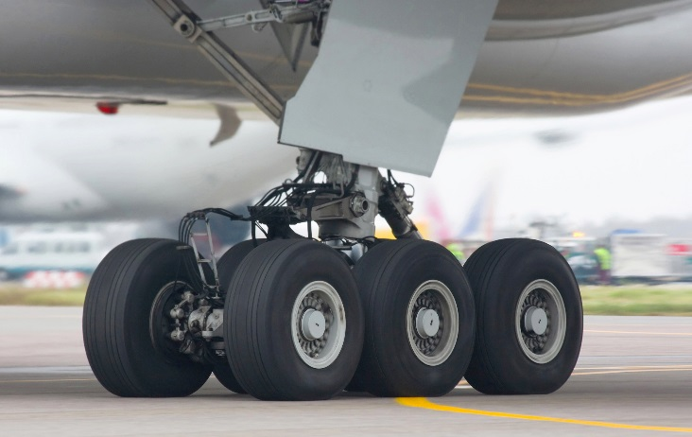
Wheels, Wheels, Wheels!

Slide 2
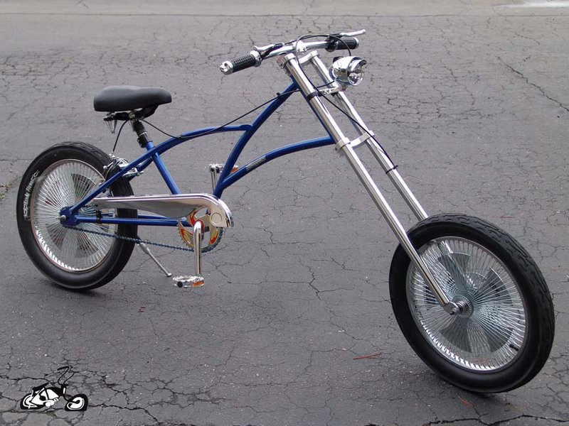

Slide 3
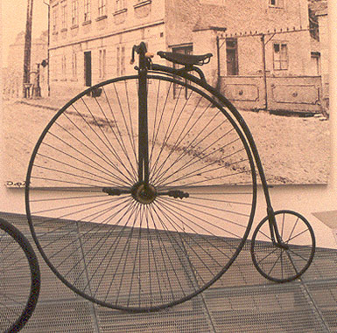

Slide 4
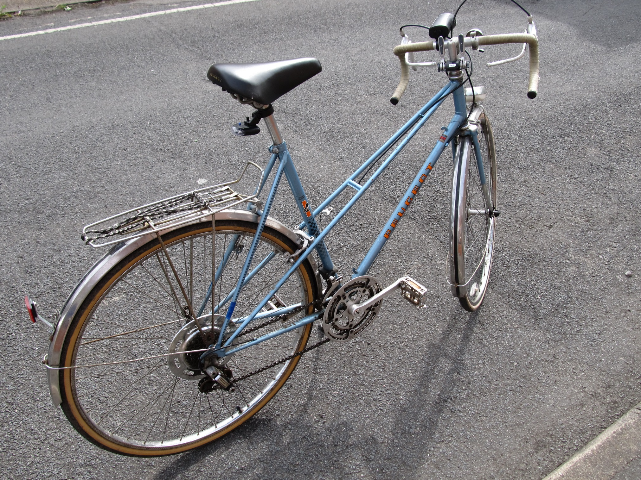

Slide 5

Have you ever thought about the size of wheels and the distance traveled for each rotation?

Slide 6
Ratios: Wheels, Rotations and Ratios
You know that wheels come in many different sizes. Take the example of a bicycle, a car or an EV3 robot.
What would the ratio be of a car wheel rotations to the number of feet it travels?
How about a robot with wheels?
What about the ratio of boys to girls in a large audience?
Ratios are important ideas to learn for everyday practical uses.
This flipped classroom lesson relates to Common Core Mathematic Standards: 6 RP.A.1 and 6 RP.A.2.

Slide 7
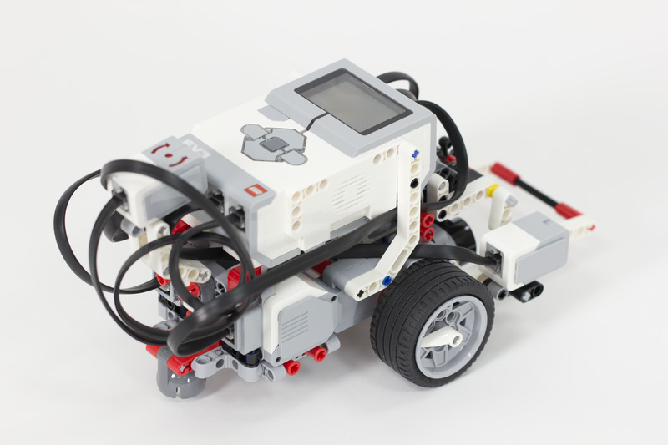
EV3 Robot- Wheels
Five wheel rotations for the robot is equal to 88 cm.
With this knowledge, you can solve problems to make the robot move a certain distance using mathematical ratio solutions.

Slide 8
Problem A: If the EV3 robot travels 88 cm in 5 rotations, how many centimeters would the robot travel if the wheels rotated 9 times? You can try this one first on paper if you like before viewing the answer.

Slide 9
Problem B: If the EV3 robot travels 88 cm in 5 rotations, how many rotations would the robot complete in order to travel 211.2 cm? Try this one on paper first before viewing the answer.

Slide 10

Practice problems for you to complete in your notebook.
If the EV3 robot travels 88 cm in 5 rotations, how many centimeters would the robot travel if the wheels rotated 14 times?
How far in centimeters does the EV3 robot travel in 1 rotation of the wheels?
If the EV3 robot travels 88 cm in 5 rotations, how many rotations would the robot complete in order to travel 302.6 cm?
If 4 ears of corn cost $2, how much would 20 ears of corn cost?

